Slide 1


MLA Documentation Tutorial
How to Cite Using MLA Style
Dr. E. Lewis
Sports Leadership and Management High School

Slide 2
What Will this Tutorial Cover?
How and when to cite within your text according to the MLA style
How to create a Works Cited page, citing a variety of sources:
  Print
  Electronic
  Media
What to do if you come across something unusual not covered in this tutorial

Slide 3

What is MLA?
MLA stands for Modern Language Association which promulgates guidelines for preparing student research papers and projects and scholarly manuscripts in the humanities. “MLA style” refers to a system of citing research sources.

Slide 4
Why Should I Cite?
Citing identifies and credits sources used in a research paper or project, acknowledging their role in shaping your research. This also allows others to follow-up on or retrieve this material.
When you borrow from other sources to support your argument or research you must give proper credit. By crediting your sources, you avoid plagiarism. If you do not cite a source, you are guilty of plagiarism.
Plagiarism is a form of cheating or stealing. It is the unacknowledged use or appropriation of another person’s words or ideas.

Slide 5
When Should I Cite?
When in doubt, give
credit to your source!
Many students plagiarize unintentionally. Remember, whenever you summarize, paraphrase or quote another author's material you must properly credit your source.
If you are using another person’s idea, you must also cite your source!
My mother always
said, “Make your bed”
(Mom 12).

Slide 6
Summary, Paraphrase, Quote
In any of these cases, you must credit your source
A summary (aka ‘abstract’) briefly captures the main ideas of your source
A paraphrase is a restatement of the text of your source in your own words
Quotations can be direct (using quotation marks) or indirect (no quotation marks and often introduced by ‘that’)
  A noted scientist states, “A hundred years ago, the average temperature of the earth was about 13.7°C (56.5°F); today, it is closer to 14.4°C (57.9°F)” (Silver 11).
  A noted scientist observes that the earth’s current average temperature is 57.9°F compared to 56.5°F a hundred years ago (Silver 11).

Slide 7
How Do I Cite?
There are two parts to citing according to MLA style:
1. Brief In-text citations (in parentheses) within the body of your essay or paper
2. List of full citations in the Works Cited page at the end of your paper
Note:
References cited in the text must appear in the Works Cited.
Conversely, each entry in the Works Cited must be cited in the text.

Slide 8
MLA provides these guidelines for citations:
In-text:
“References in the text must clearly point to specific sources in the list of works cited” (Gibaldi 214).
Works Cited:
“Identify the location of the borrowed information as specifically as possible” (Gibaldi 215).

Slide 9
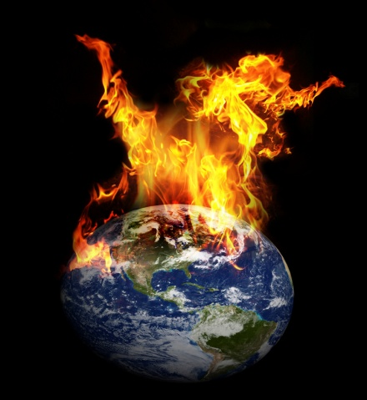
In-Text Citations
You must provide information that will allow the reader to locate exactly where you found information in your sources. Usually this is the author's last name and a page number, for example: (Polar 188)
Place the parenthetical reference at the end of the sentence before the punctuation mark.
  The average world temperature is rising at an alarming rate of 200 degrees Celsius per year (Polar 188).

Slide 10
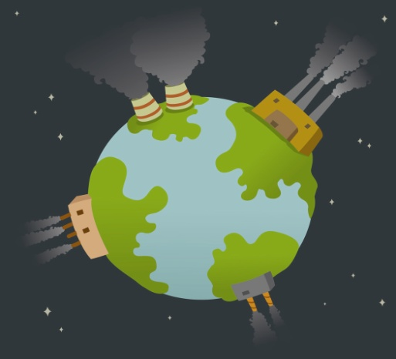
In-Text Citations, Continued
If you use an author's name in a sentence (known as a “signal phrase”), do not use it again in the parenthetical citation. Simply give the page numbers:
  Polar argues that global warming will help heat our jacuzzis (122).
If there is no known author, use the title and page number in your citation:
  A single car trip from Los Angeles to San Francisco produces more pollution than a tree does in its entire lifetime (Save My Greenhouse 47).

Slide 11
Other Citation Possibilities
More than one page:
Smith states some interesting facts about the changing world temperature (123-25).
Citing two (page) locations from your source:
Jones alludes to this premise (136-39, 145).
Two works cited:
(Taylor 54; Thomas 327)
When you cite more than one work by the same author in your paper, indicate which work in your parenthetical citation:
Everyone hates global warming (Smith, Our Environment 87).
When possible, give only the last
two digits for the second number
Cite as you normally would and
separate citations with a semicolon
Author Comma Title Page Number

Slide 12
In-Text Citations-
Electronic Sources
If possible, electronic and online sources are cited just like print resources in parenthetical references.
Often electronic resources will not have page numbers. In these cases omit numbers from the parenthetical reference:
  (Smith) – the author’s last name
  (“Bovine Flatulence A Major Source of Greenhouse Gases”) – if no author

Slide 13
Works Cited Page
The Works Cited Page appears at the end of your paper on its own page.
Everything you referenced in your text must be listed in your Works Cited page. Conversely, everything you list in the Works Cited page must be cited in your essay.
The Works Cited page provides the information needed for a reader to find and retrieve any source used in your paper.

Slide 14
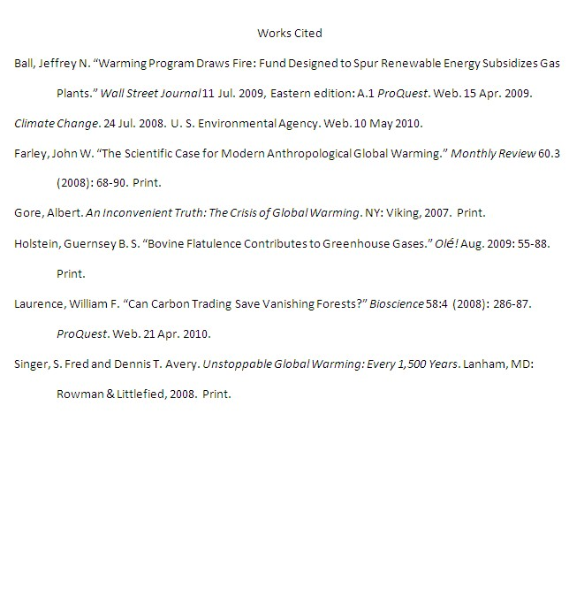
Sample Works Cited Page
*Sources are listed alphabetically
Title “Works Cited” is centered
at the top of the page
Indent all lines after
the first ½ inch for
each work listed
Be sure that each citation has a format descriptor (properly placed within the citation); e.g., Web, Print, Film
*The entire Works Cited page is
double-spaced
All citations end in a period (.)

Slide 15
Most Citations Will Include:
For a book, most of this information
can be found on the title page and
obverse of the title page.
Author
Title
Publication information
Format descriptor
Gore, Albert. An Inconvenient Truth: The Crisis of Global Warming. New York: Viking, 2007. Print.
Last Name, First Period
Italicized Title
Period
Format descriptor
Period
Year
Period
City Colon Publisher Comma

Slide 16
General Tips:
Print Resources
PRINT RESOURCES
Book titles are italicized:
An Inconvenient Truth: The Crisis of Global Warming
Article titles and titles of chapters, essays and short stories appear in quotes:
"The Scientific Case for Modern Anthropogenic Global Warming."
If more than one author is given, list first author’s “Last Name, First.” The second or third authors should be listed “First Name Last Name” with “and” connecting the last name:
Singer, Fred S., Christopher Hogwood, and Dennis T. Avery.

Slide 17

Books
What Should Be Included?
PRINT RESOURCES
Author(s) or Editor(s).
Complete title.
Edition (if indicated).
Place of publication:
Publisher,
Date of publication.
Format descriptor.
Gore, Albert.
An Inconvenient Truth: The Crisis of Global Warming.
New York
Viking
2007.
Print.
If several cities
are listed, give
only the first

Slide 18

Book Examples
PRINT RESOURCES
With one author:
Gore, Albert. An Inconvenient Truth: The Crisis of Global Warming. New York: Viking, 2007. Print.
With two to three authors:
Singer, Fred S. and Dennis T. Avery. Unstoppable Global Warming: Every 1,500 Years. Lanham, MD: Rowman & Littlefield, 2008. Print.
Italicize title of book
Use a colon between the
main title and the subtitle
List the first author Last Name, First,
but the second First Name then Last.
Remember to indent
the second line ½ inch
Postal codes for states of lesser-known cities

Slide 19
Books, Continued
PRINT RESOURCES
For books with editors, list the editor’(s)
name(s) followed by “eds.”
Editors as authors:
Schmandt, Jurgen and Judith Clarkson, eds. The Regions and Global Warming: Impacts and Response Strategies. New York: Oxford University Press, 1992. Print.
Book by a corporate author:
National Research Council. China and Global Change: Opportunities for Collaboration. Washington: Natl. Acad., 1992. Print.
Cite a book by corporate author

Slide 20
Two or More Sources by the Same Author:
Firor, John. The Changing Atmosphere: A Global Challenge. New Haven, CT: Yale University Press, 2009. Print.
---. The Crowded Greenhouse: Population, Climate change, and Creating a Sustainable World. New Haven, CT: Yale University Press, 2002. Print.
For the second listing by the same author, type
three hyphens and a period in place of the name.

Slide 21

Periodical Articles
What Should Be Included?
PRINT RESOURCES
Depends on the type of periodical: Newspaper, Magazine, or Journal
But they generally require this information
Author(s).
Article title in quotes.
Periodical title (journal, magazine, etc.) italicized.
Volume #.Issue #
Publication date (abbreviate months, if used):
Page numbers of the article.
Format descriptor.
Notes:
21

Slide 22

What Should Be Included?
Journal Articles
PRINT RESOURCES
Farley, John W.
"The Scientific Case for Modern Anthropogenic Global Warming."
Monthly Review
60.3
(2008):
68-90.
Print.
Author(s).
Article Title in Quotes
Periodical Title (journal, magazine, etc.) Italicized.
Volume #.Issue #
Publication Date (abbreviate months, if used):
Page Numbers of the Article.
Format.

Slide 23

Articles
PRINT RESOURCES
Journal:
Farley, John W. "The Scientific Case for Modern Anthropogenic Global Warming." Monthly Review 60.3 (2008): 68-90. Print.
Magazine:
Manthorpe, Catherine. "Feminists Look at Science." New Scientist 7 Mar. 1985: 29-31. Print.
Newspaper:
Tilgham, Shirley M. "Science vs. Women--A Radical Solution." New York Times 26 Jan. 1993, late ed.: F1+. Print.
Article title in quotes
Italicize the name of the
journal, magazine or newspaper
Volume 60 Issue 3
If available give complete date: day, month and year
If a newspaper article continues on another page,
write only the first page number and a plus sign

Slide 24
General Tips
Electronic Resources
ELECTRONIC
RESOURCES
Dates: It is very important that you always include the date you accessed the electronic or online source. You should also include the date the source was published or last updated.
Database: Indicate the name of the database, like ProQuest or LexisNexis, italics.
Format descriptor: Indicate that it’s a web source with the word, Web.

Slide 25
Internet Sources
What Should Be Included?
ELECTRONIC
RESOURCES
Author(s), if available:
Title of the document.
Title of scholarly project, database, periodical, or website.
Date electronic publication was last updated.
Name of the organization sponsoring or associated with the site.
Format descriptor.
Date when you accessed the source.
“Global Warming.”
Stanford Solar Center.
2008.
Stanford University.
Web.
4 Apr. 2010

Slide 26
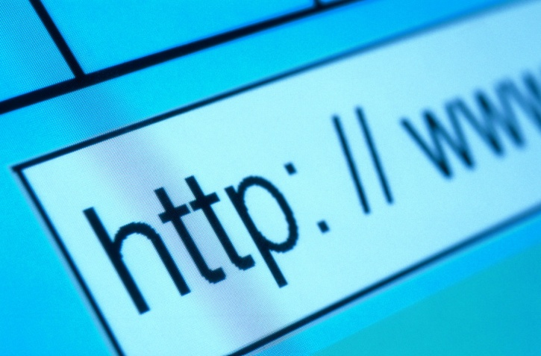
Websites
ELECTRONIC
RESOURCES
Climate Change. 24 Jul 2008. U.S. Environmental Protection Agency. Web. 4 Apr. 2010.
“Global Warming.” Stanford Solar Center. 2008. Stanford University. Web. 4 Apr. 2010.
Date accessed
Abbreviate the month
Date source was last updated

Slide 27
Electronic Articles
ELECTRONIC
RESOURCES
Journal:
Laurance, William F. "Can Carbon Trading Save Vanishing Forests?" Bioscience 58.4 (2008): 286-87. ProQuest. Web. 4 Apr. 2010.
Volume #.Issue# (Year of publication)
Access date
Database, italicized

Slide 28
Electronic Articles, Continued
Newspaper:
Ball, Jeffrey N. “Warming Program Draws Fire; Fund Designed to Spur Renewable Energy Subsidizes Gas Plants." Wall Street Journal [New York, N.Y.] 11 Jul 2008, Eastern edition: A.1. Web. 4 Apr. 2010.
Date article was published
Format descriptor
Date of access
Place of publication is in brackets when it is not explicitly indicated in the publication itself

Slide 29

Electronic Books
ELECTRONIC
RESOURCES
Sweet, William. Kicking the Carbon Habit: Global Warming and the Case for Renewable and Nuclear Energy. New York: Columbia University Press, 2006. NetLibrary. Web. 4 Apr. 2010.
Moser, Susanne C. Creating a Climate for Change: Communicating Climate Change and Facilitating Social Change. Cambridge, New York: Cambridge UP, 2007. NetLibrary. Web. 4 Aug. 2010.
“University Press” can be abbreviated “UP”
Again, include date of access and format descriptor

Slide 30
Media Sources
MEDIA
SOURCES
Multimedia sources can also be used
and cited
Media sources (examples):
TV & radio broadcasts
Films & video recordings
Sound recordings
Format descriptors:
Television; Radio
Film; DVD; Video Recording
CD; Sound Recording

Slide 31
Media Sources
What Should Be Included?
MEDIA
SOURCES
“Title of The Episode.”
Title of program or series.
Name(s) of director(s), performer(s), narrator(s)
Name of Network.
Call Letters and City of Station.
DD MMM. YYYY.
Format descriptor
“The Yada Yada”
Seinfeld
Perf. Elaine Benes, George Constanza, Cosmo Kramer, and Jerry Seinfeld
National Broadcasting Corp.
KNBC, Los Angeles
24 Apr. 1997
Television.

Slide 32
Works Cited
MEDIA
SOURCES
Badu, Eryka. “Rimshot.” Eryka Badu Live. Universal Records. 1997. CD.
The Girl with the Dragon Tattoo. Dir. Niels Arden Oplev. Perf. Noomi Rapace and Michael Nyquist. Music Box. 2009. Film.
Joyce, James. Ulysses. Perf. Jim Norton and Marcella Riordan. Naxos Audiobooks. 2004. CD.
“The Yada Yada.” Seinfeld. Perf. Elaine Benes, George Constanza, Cosmo Kramer, and Jerry Seinfeld. National Broadcasting Corp. KNBC, Los Angeles, 24 Apr. 1997. Television.

Slide 33
The MLA ‘Bible’
If you come across anything not mentioned in this presentation or need further information, consult the MLA Handbook
in the library!
There are many more examples
and much useful information inside!
Gibaldi, Joseph. MLA Handbook for Writers of Research Papers. 7th ed. New York: Modern Language Association of America, 2009. Print.
Trimmer, Joseph F. A Guide to MLA Documentation: with an Appendix to APA Style. 8th ed. Boston: Wadsworth, 2010. Print.

